Slide 1
Systolic Processor Array using FPGA
Guide:- Team Members:
Mr. Rashid P.E 20. Deepak J Puthukkaden
31. Giridhar A K
32. Govindh B
53. Rohit Sreekumar
59. Shine Ali

Slide 2
OBJECTIVE
To study on Systolic Architecture
To design and Implement an n-bit Processor using Systolic Array Architecture on FPGA prototyping platform

Slide 3
Working Example of Matrix Multiplication using Systolic Array

Slide 4
0
0
3
2
1
0
1
3
2
0
2
1
3
0
0
DPU 1
DPU 2
DPU 3
0 | 0 | 3 | 2 | 1
DPU 4
DPU 5
DPU 6
0 | 1 | 3 | 2 | 0
DPU 7
DPU 8
DPU 9
2 | 1 | 3 | 0 | 0

Slide 5
Clock 1
0
0
3
2
0
1
3
2
2
1
3
0
1*1
1
0 | 0 | 3 | 2
1
0 | 1 | 3 | 2
2 | 1 | 3 | 0

Slide 6
Clock 2
0
0
3
0
1
3
2
1
3
1*1+2*2
2
1*2
0 | 0 | 3
1
2
2
2*1
0 | 1 | 3
2
1
2 | 1 | 3

Slide 7
Clock 3
0
0
0
1
2
1
1*1+2*2+3*3
3
1*2+2*3
1*3
0 | 0
2
3
3
3
2*1+3*2
2*2
0 | 1
3
2
2
2
3*1
2 | 1
3

Slide 8
Clock 4
0
0
2
1*1+2*2+3*3
0
1*2+2*3+3*1
1*3+2*1
0
3
0
1
1
2*1+3*2+1*3
2*2+3*3
2*3
0
1
3
3
3
3
3*1+1*2
3*2
3
2
1

Slide 9
Clock 5
0
0
0
1*1+2*2+3*3
0
1*2+2*3+3*1
1*3+2*1+3*2
0
0
0
0
2
2*1+3*2+1*3
2*2+3*3+1*1
2*3+3*1
0
0
1
0
1
1
3*1+1*2+2*3
3*2+1*3
1
3*3
0
2

Slide 10
Clock 6
0
0
0
1*1+2*2+3*3
0
1*2+2*3+3*1
1*3+2*1+3*2
0
0
0
0
0
2*1+3*2+1*3
2*2+3*3+1*1
2*3+3*1+1*2
0
0
0
0
0
2
3*1+1*2+2*3
3*2+1*3+2*1
2
3*3+1*1
0
0

Slide 11
Clock 7
0
0
0
1*1+2*2+3*3
0
1*2+2*3+3*1
1*3+2*1+3*2
0
0
0
0
0
2*1+3*2+1*3
2*2+3*3+1*1
2*3+3*1+1*2
0
0
0
0
0
0
3*1+1*2+2*3
3*2+1*3+2*1
0
3*3+1*1+2*2
0
0

Slide 12
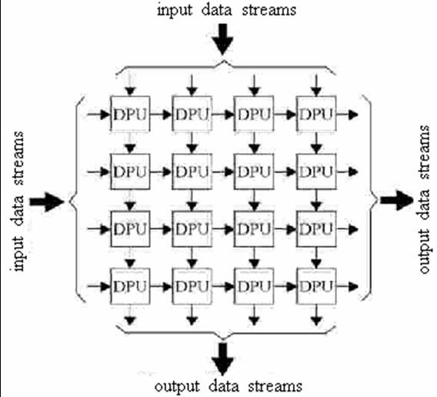
System Overview
Input Data
Systolic Processor
Output Data

Slide 13
Systolic Processor Architecture
Processor array that performs 3 by 3 matrix multiplication
Consists of 9 DPUs, each performing the task of generating partial products (multiplication and accumulation)
Consists of 4-bit PIPO shift registers that shift the input data into the DPUs
Input data ripples through the complete systolic array

Slide 14
Systolic Processor Architecture (Block Diagram)
Shift Registers (4-bit)
DPU
DPU
DPU
KEY
DPU
DPU
DPU
Data Input (4-bit)
Data Output (10-bit)
DPU
DPU
DPU
Data Interconnect (4-bit)

Slide 15
Input and Output data control modules
Input from host computer
Input
Data Bus
Controller
Input Data Bus
Input Data
Receiver Module
.
.
.
.
.
.
.
.
Input data controller
Output
Data Bus
Controller
Output Data
Transmitter Module
Output to host computer
.
.
.
.
.
.
.
.
Output data controller

Slide 16
Detailed Architecture (individual modules)
Data Processing Unit (DPU)
Interconnects
Register cache

Slide 17
1. Data Processing Unit (DPU)
Computes partial product of matrix multiplication
Consists of:
1.1. Parallel in parallel out 4 – bit shift register
1.2. Carry save multiplier
1.3. 10 – bit full adder
1.4. Parallel in parallel out 10 – bit shift register

Slide 18
DPU BLOCK DIAGRAM
Input A
(4 – bit)
Ripple Output
(4 – bit)
REGISTER (4BIT)
ADDER
(10-BIT)
MAC (4 - BIT)
Input B
(4 – bit)
REGISTER (4BIT)
REGISTER
(10-BIT)
OUTPUT
(10 – bit)
Clock
Ripple Output
(4 – bit)

Slide 19
1.1. Parallel in parallel out 4 – bit shift register
Consists of 4 positive edge triggered D – Flip flops with asynchronous clear signal
Output (4-bit)
DFF
DFF
DFF
DFF
Input (4-bit)
Clk

Slide 20
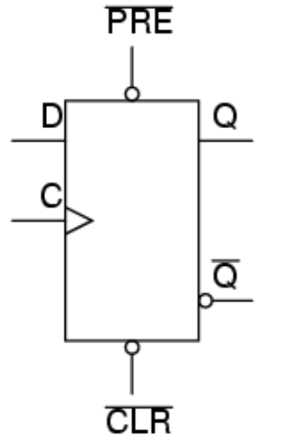
1.1.1. D-Flip Flop (DFF)
It has the following inputs
D – Data input
C – Clock input
___
CLR – Clear input (asynchronous input)
It has the following Outputs
Q – Output
_
Q – Inverted Output
The DFF that we are using here is positive edge triggered DFF
DFF

Slide 21
1.2. Carry Save Multiplier
Consists of Half adders, Full adders and AND gates
The and gate and half adders were together integrated into a single block – Full Adder Modified

Slide 22
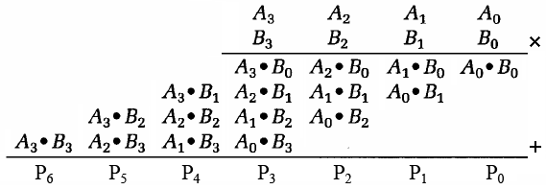
1.2. Carry Save Multiplier
Two 4-bit numbers A and B are multiplied together to the get the result
The operation is shown below
Consists of Modified Half adders and Full adders and AND gates

Slide 23
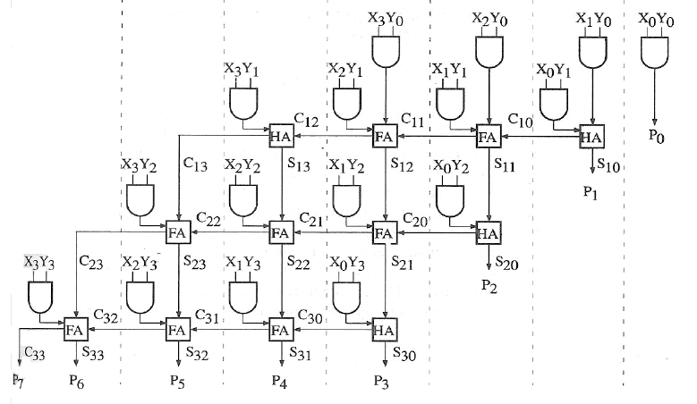
1.2. Carry Save Multiplier (diagram)

Slide 24
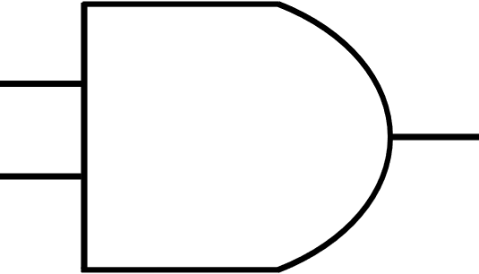
1.2.1 HAM and FAM modules
A B C
A B C D
Half Adder
Full Adder
Sum Carry
Sum Carry
Half Adder Modified (HAM)
Full Adder Modified (FAM)

Slide 25
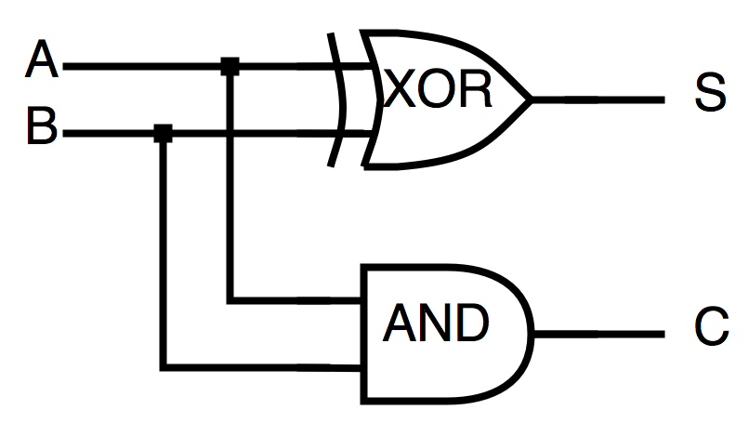
1.2.2. Half Adder
S = A XOR B
C = A AND B

Slide 26
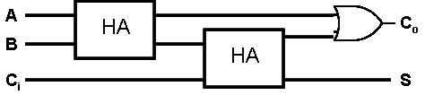
1.2.3. Full Adder
S = A XOR B XOR Ci
Co = (A AND B) OR ((A XOR B) AND Ci)
HA – Half Adder

Slide 27
1.3 Full Adder (10 – bit)
Consists of 9 full adders and 1 half adder
INPUTS (10 – BIT)
FA
FA
FA
FA
FA
FA
FA
FA
FA
HA
OUTPUTS (10 – BIT)

Slide 28
1.4. Parallel in parallel out shift register (10 – bit )
Consists of 10 positive edge triggered D – Flip flops with asynchronous clear signal
Output (10-bit)
DFF
DFF
DFF
DFF
DFF
DFF
DFF
DFF
DFF
DFF
Input (10-bit)
Clk

Slide 29
2. Interconnects
The interconnect consists of a 4 – bit wide bus that facilitates the rippling of input data in each rising edge of the clock
There are three outputs per DPU, two of which are interconnects for the data rippling between the DPUs

Slide 30
3. Register cache
Shift input
Consists of 5, 4 – bit registers that are used to store the input data to be given as input to the DPUs
Shift output

Slide 31
Tree structure of DPU
DPU
PIPO
DFF
MAC
Adder
HAM
FAM
AND
HA
AND
FA
HA
OR
XOR
AND
XOR
AND
FA
HA
HA
OR
XOR
AND
XOR
AND
AND

Slide 32
Implementation Overview
Host Computer
Systolic Processor Array
(Acts act a co-processor)
Data Flow

Slide 33
Implementation
Implementation plan : Raspberry Pi – Host computer
Systolic Processor Array (FPGA) – Co-processor
Communication protocol – Serial protocol
Working
Raspberry Pi sends data (input matrix) to the FPGA
FPGA processes the data
The output of the PFGA is fed back to the Raspberry Pi

Slide 34
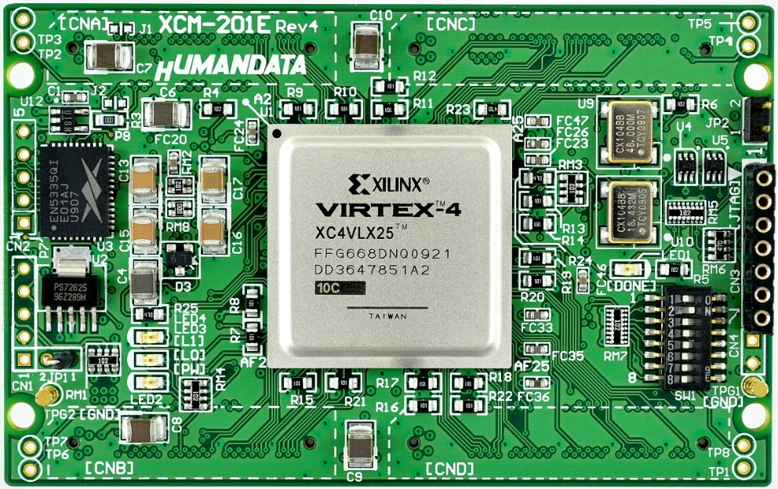
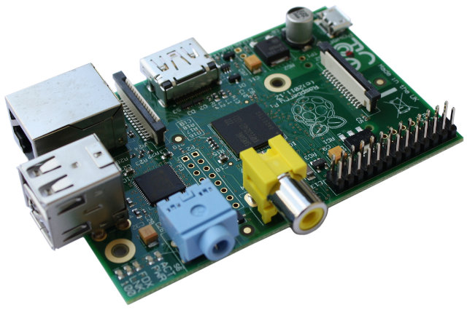
Implementation (Block Diagram)
RASPBERRY PI
FPGA VIRTEX 4
I2C
I2C

Slide 35
Task Completed
Coding and testing of MAC, Adder, Shift register modules
Coding and testing of the individual DPU
VHDL coding and testing of interconnects between DPU’s
RTL synthesis of 3 * 3 matrix architecture
Testbench simulation of 3 * 3 matrix DPU architecture

Slide 36
Tasks to be completed
Input data module design and implementation
Output data module design and implementation
Raspberry pi – FPGA interface

Slide 37
THANKYOU

